Slide 1
Watermall concept 0.1 - 17.10.2014
Lucas, Mar, Jason

Slide 2
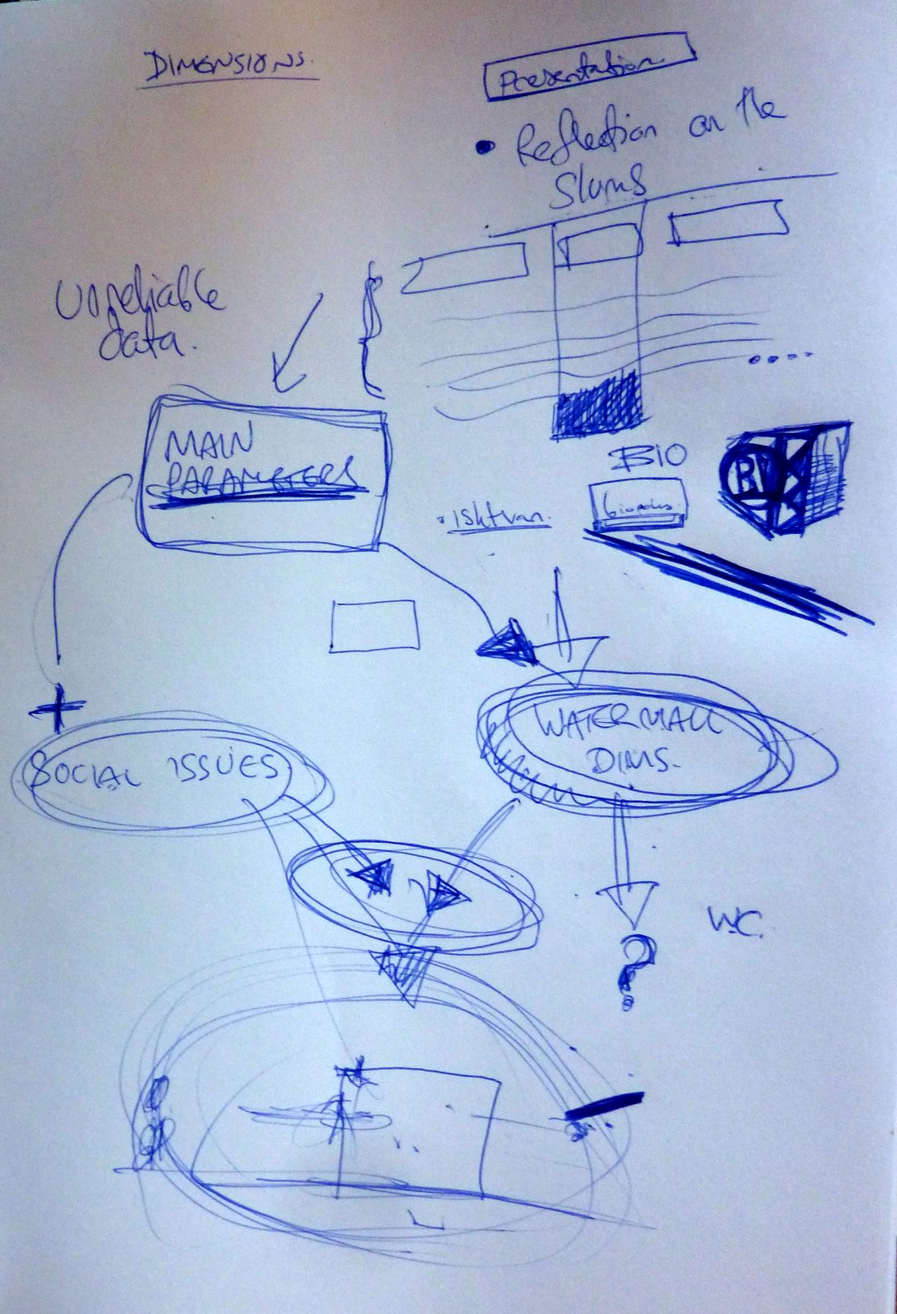
Contents
case studies
reliable data?
main social parameters
main technical parameters
dimensioning the watermall
food production - water & energy - storage, etc...
concept 0.1

Slide 3
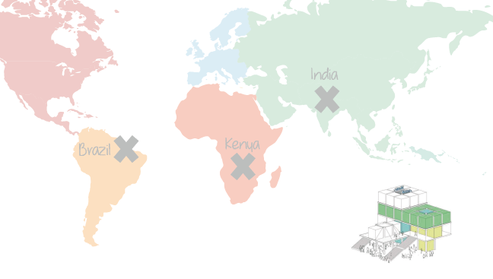
Case studies from 3 continents

Slide 4
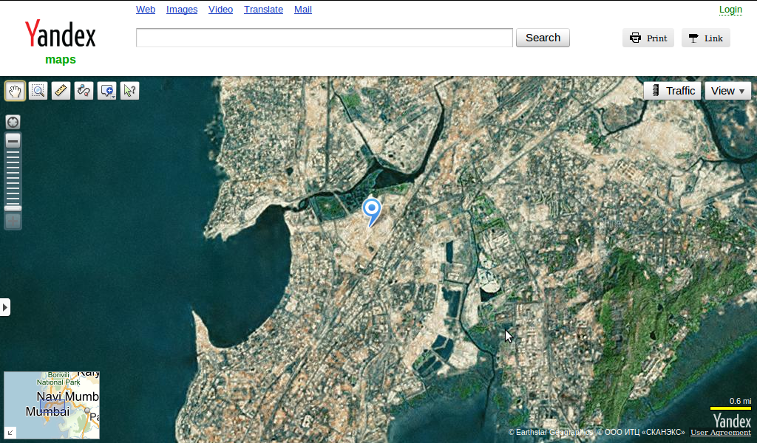
Case studies - Dharavi

Slide 5
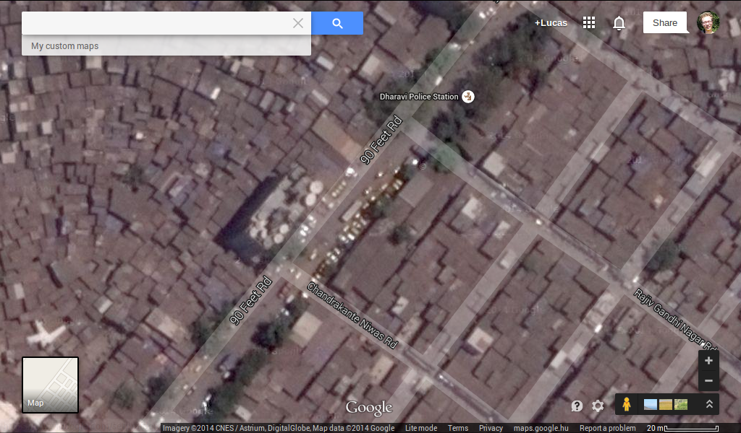
Case studies - Dharavi

Slide 6
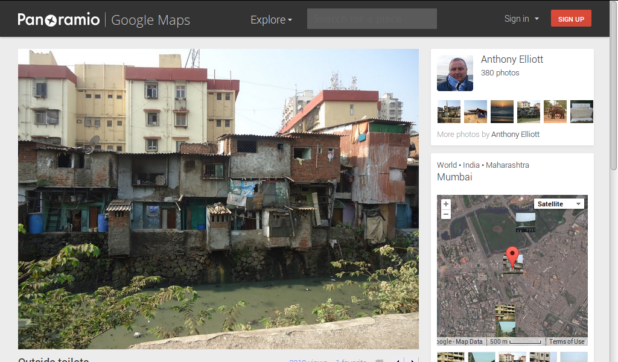
Case studies - Dharavi

Slide 7
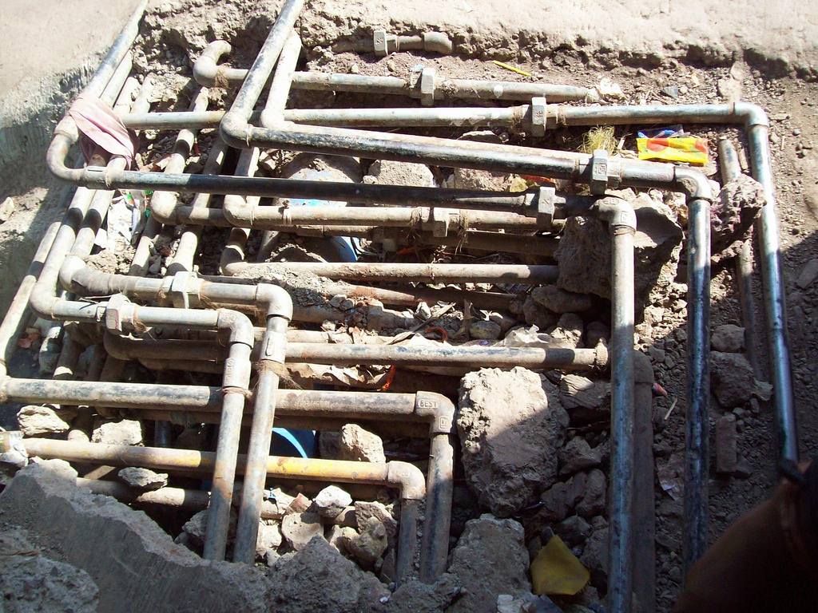
Case studies - Dharavi

Slide 8
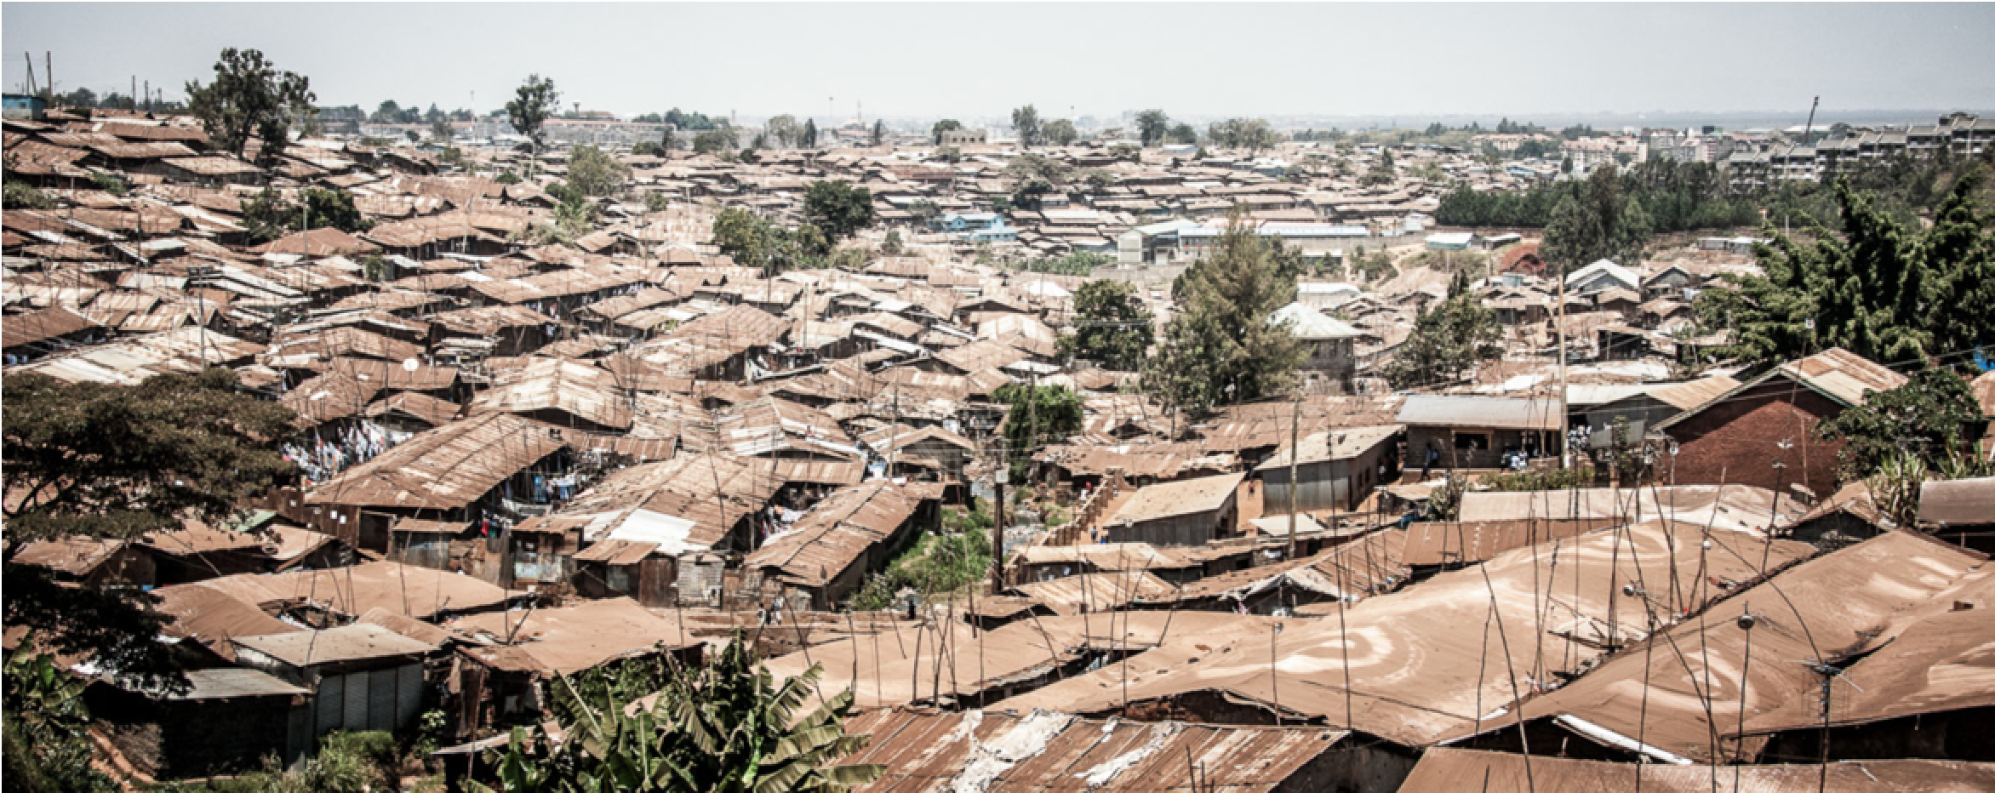
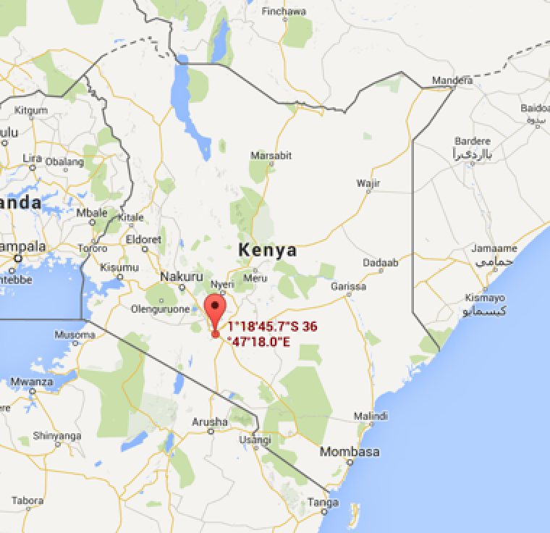
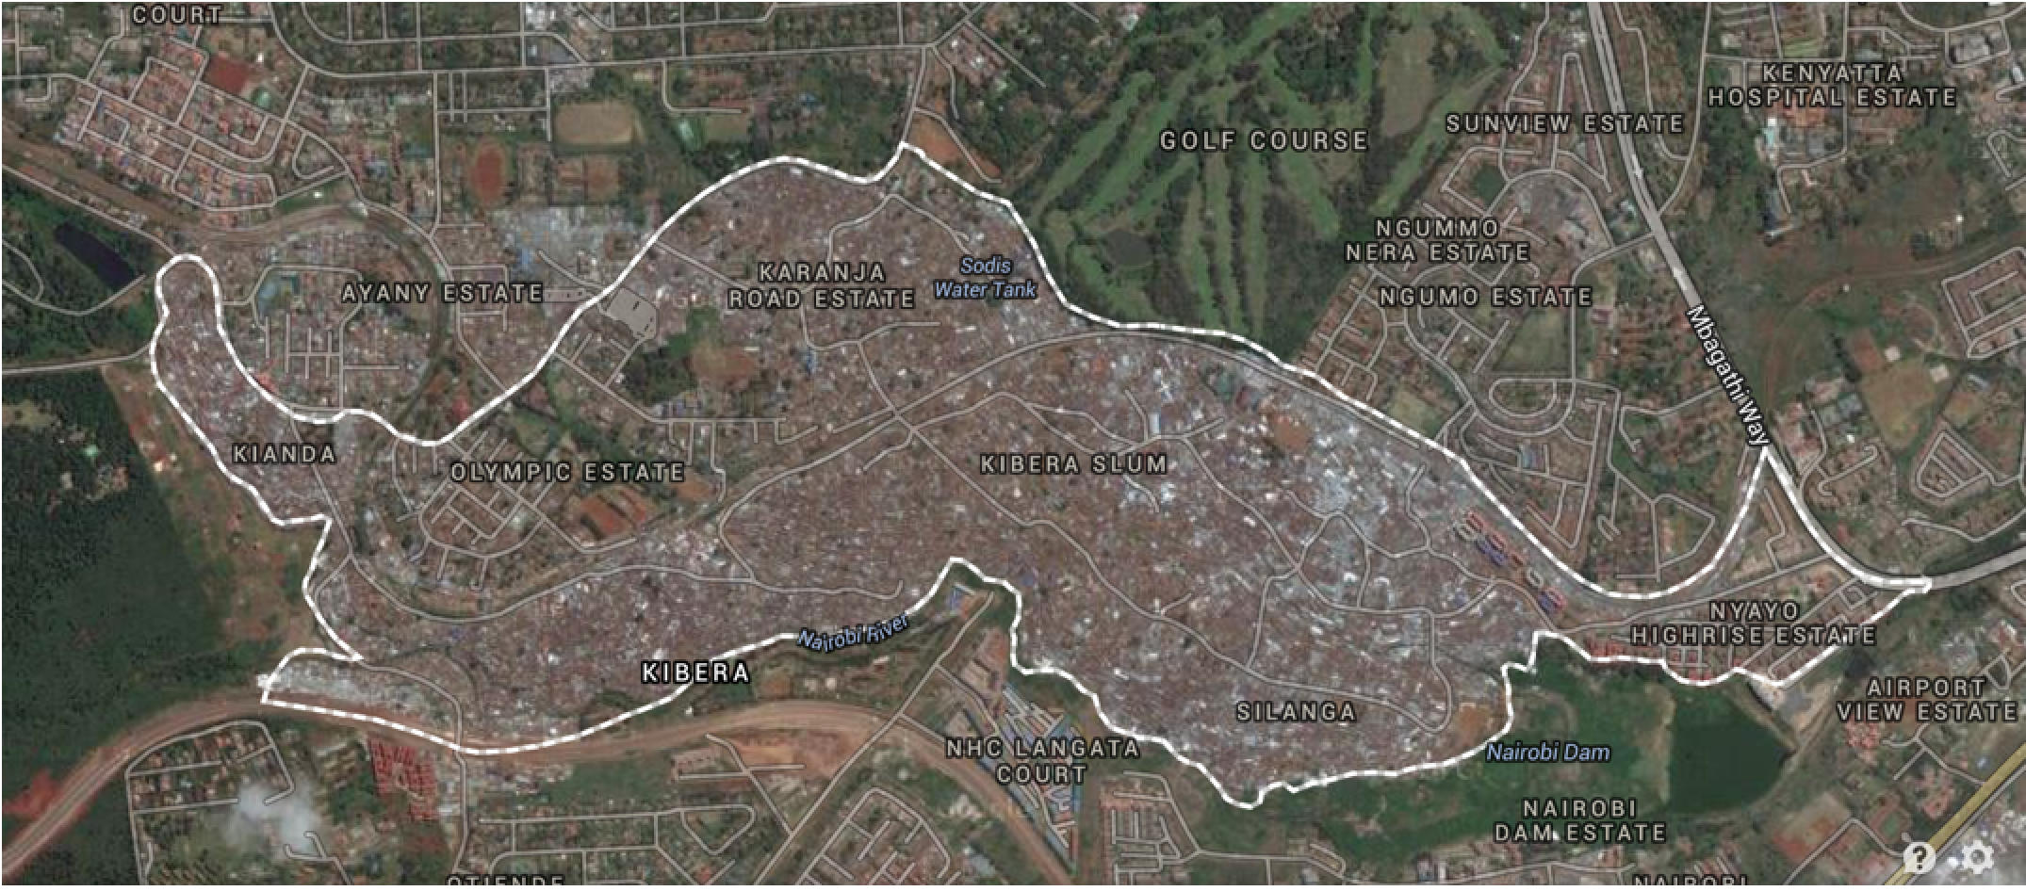
Case studies - Kibera

Slide 9
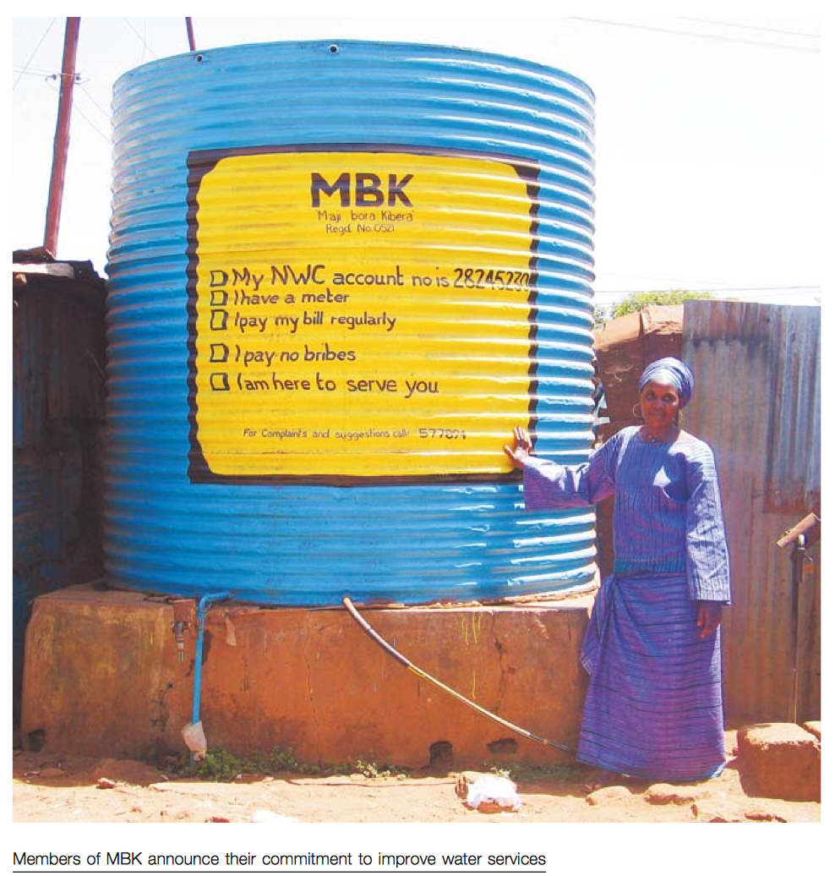
Case studies - Kibera

Slide 10
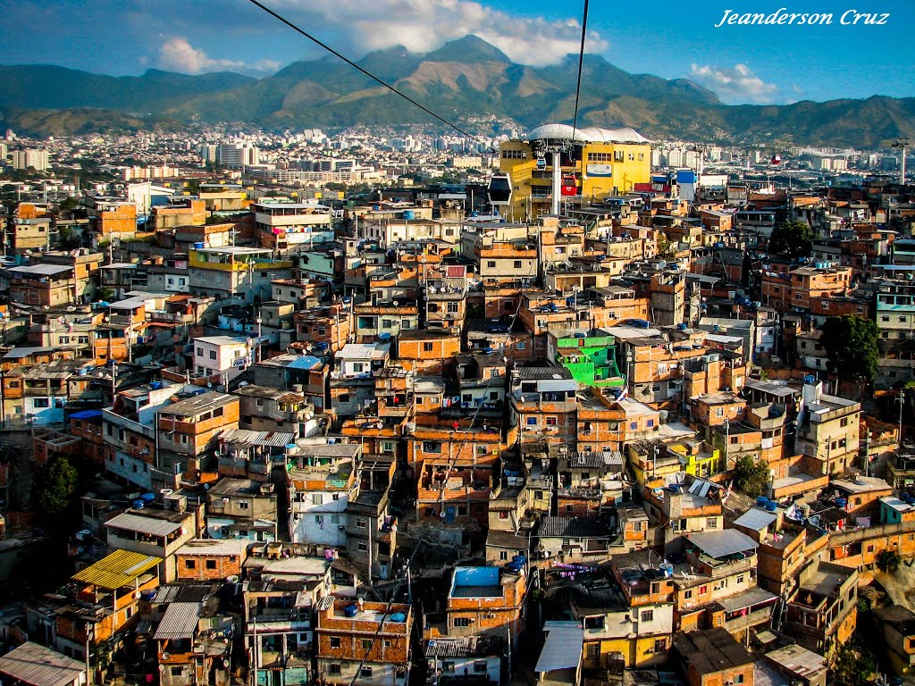
Case studies - Alemão, Rio

Slide 11
Case studies - Alemão, Rio
Access to sanitation:
Access to water:
Houses with own toilet (99.8%); without toilet (0.2%)
99% has water at home

Slide 12
Reliable data?
flying shit bags?
only 600 toilets for 200 000 + people?
1554 people : 1 toilet <-> 150 people : 1 toilet?
It is important a first hand socio-economic study
Notes:
Overall the 3 case studies were not the best choices to get an understanding of rapidly growing slums. They were chosen since there was a lot of available information on the slums. Rio was already highly developed and Kirbera and Dharavi slums were quite old slums where the boundaries were already set and many behaviors and norms had already been established. Not that they couldn't use a Watermall, but other places may benefit more.

Slide 13
Killer social parameters
Cultural toilet and water habits
Ongoing water and energy activities (suppliers)
Income profiles (distribution of rich and poor)
Power relations (narco-traffic, violence, corruption)
Are there existing DEVELOPMENT plans for the slums (Dharavi example)

Slide 14
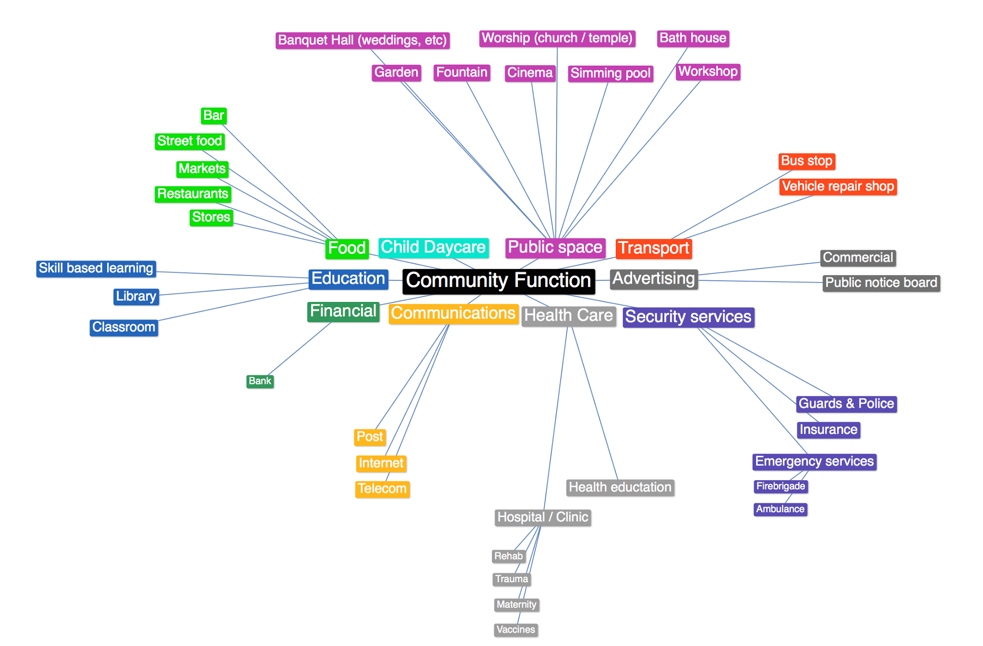
Notes:
From workshop one we tried to define what kinds of community functions exist. to get an idea of what additional sociall services the Watermall could offer.

Slide 15
Notes:
I idea was that we would design a water mall based on the following factors, but from reading the case studies we realized that every place is incredibly case specific and so to make a design for specific slums or cultures or sub-cultures would not be practical, so we moved on to technical parameters to see if we can find some common features. Basically the minimum needs of people regardless or region. This too is a loaded extercise because we wish to increase their standard of living also to something that we’re more familiar with in the west.

Slide 16
Main technical parameters
population density
amount of excreta / day (where do you poo?)
water and sanitation access %
water sources
water / energy consumption
energy / water / sanitation prices
logistical access

Slide 17
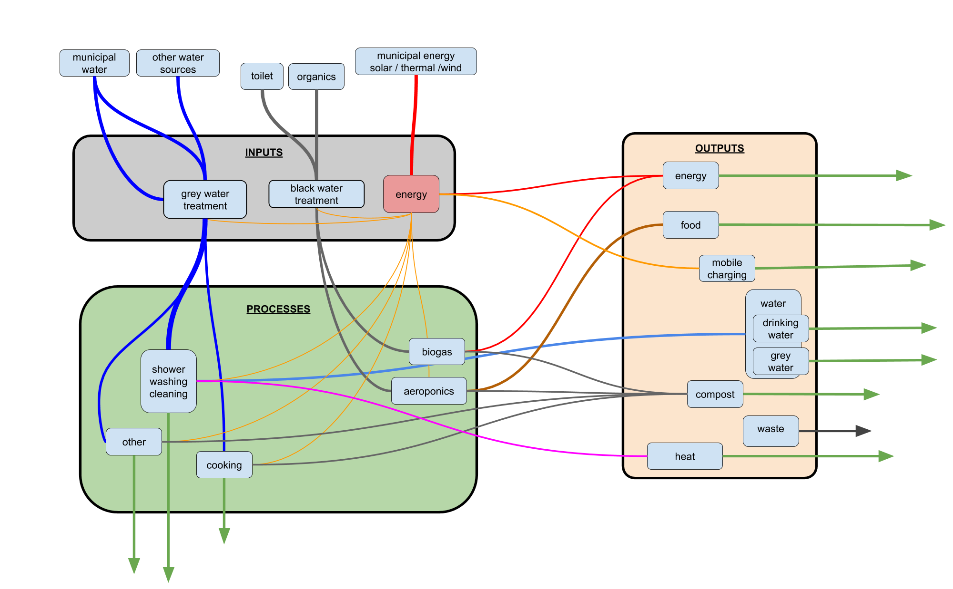

Slide 18
Population density:
Kibera slum
Dimensions of the water mall
1 Km 5 min
8 T poo /day
45 m3 pee /day
40.000
6.000 kg of biogas
=80.000 kWh /day
Water recycle:
400 m3/day
1.4 kg spinach/ person/month
Water use
700 m3/day
3 l/person/day
5.5 m3/day
Energy use:
20.000 kWh /day
Water loss: 300 m3/day

Slide 19
A business case
toilets are free to use
community acceptance
gas / electricity
drinking water

Slide 20
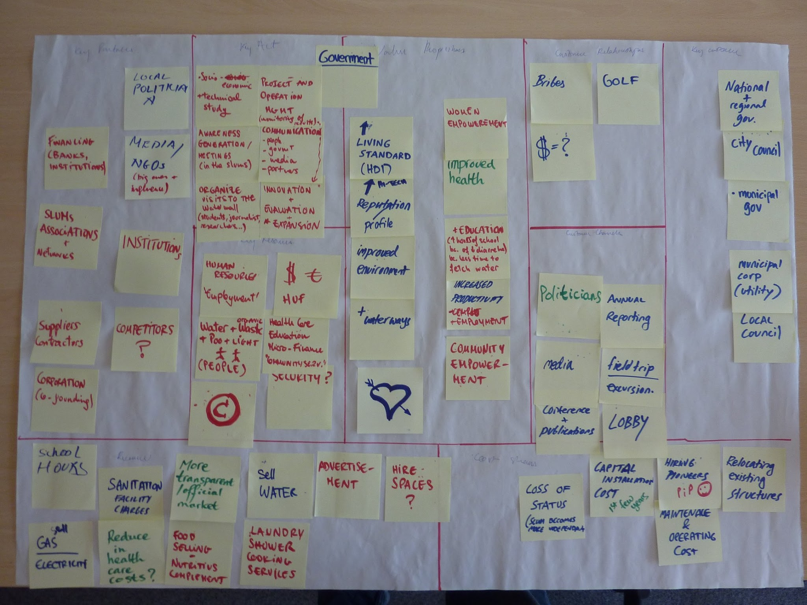
Business model canvas

Slide 21
Value propositions
increased health
environment (surface water)
environment (sea, fish yields, oxygiun marine algae)
safety (health + personal)
reputation of the municipality (city)

Slide 22
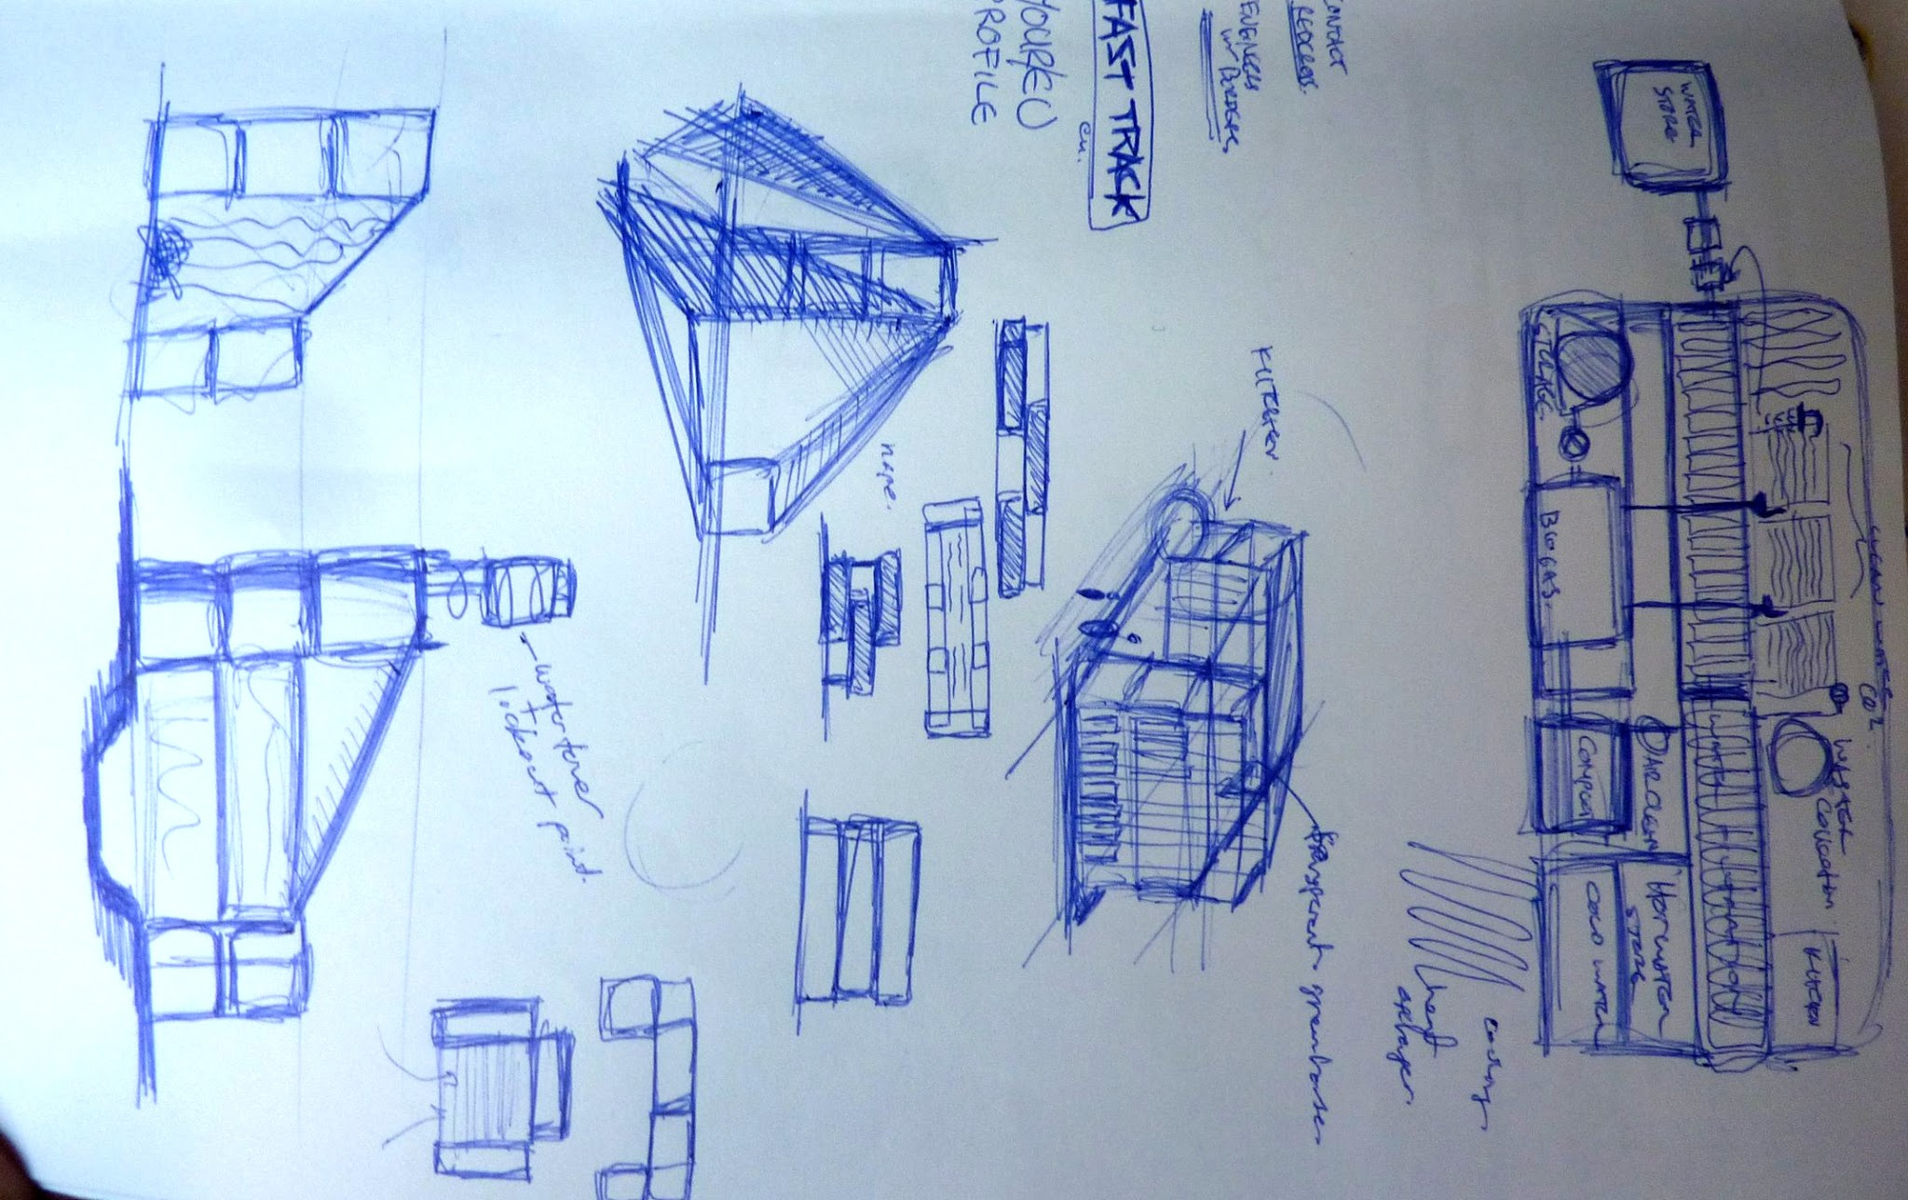
Notes:
Some sketches by Jason of a structure of shipping containers. You can build them, then ship them to the watermall place and connect them into the modular system.

Slide 23
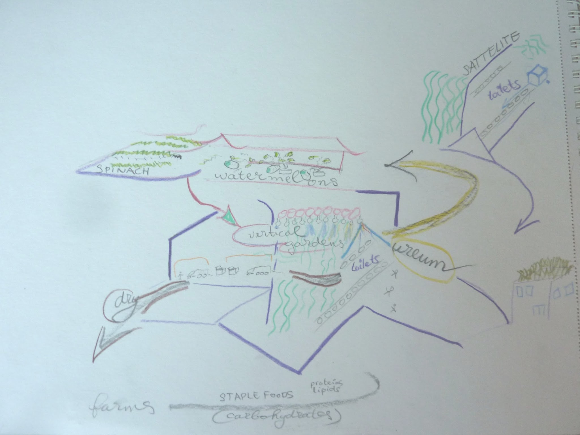
Notes:
Horizontal re-use of nitrogen and other nutrients (top, left) can be changed into vertical/hanging gardens. Here you see how dry faeces are transported to an offsite digester in minitrucks, to be used on farms, which closes the loop when grains, nuts and dairy also cofrom outside the city.

Slide 24
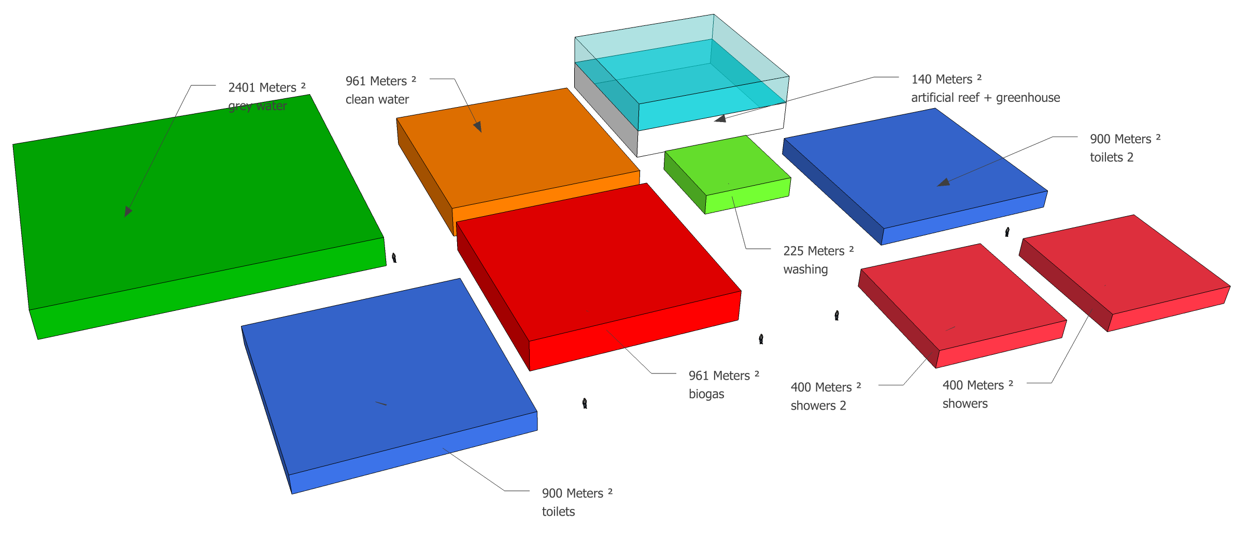
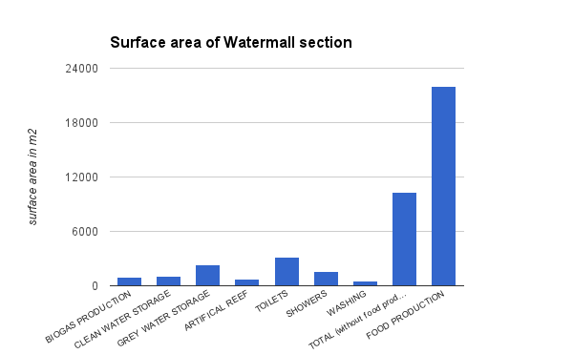
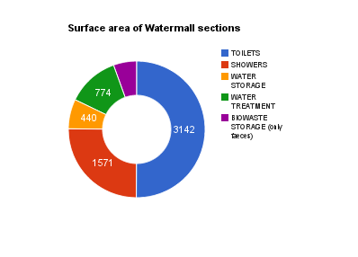
Notes:
Top right: surface area Watermall [digester, water storage, showers and toilets, grey water treatment, but without the food production] --- Things we did not count in the surface area: washing machines, membrane filter for recycling grey water, compressor for biogas, biogas storage]

Slide 25
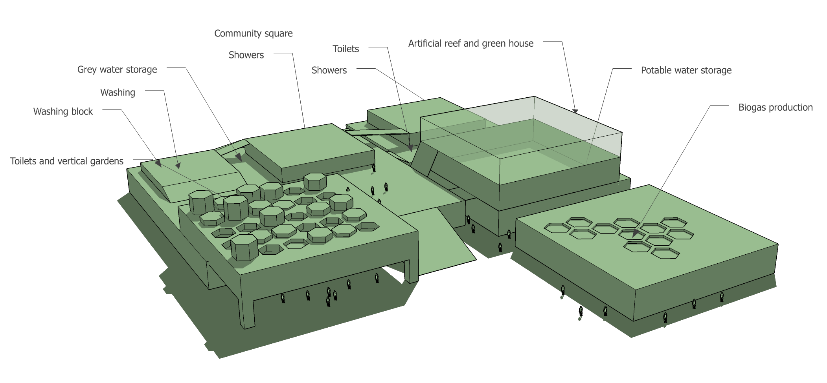

Slide 26
Dimensions (1)
walking dist | 5 | min (6km/h)
distance | 1 | km
population density | 50000 | hab/km2
people served | 39270 | hab
poo | 202.5 | g/poo/person/day
urine | 1.15 | l/pee/person/day

Slide 27
Dimensions (3)
Population density:
Kibera slum
DIMENSIONS OF THE WATERMALL
Biowaste storage | 4767 | m3 with 30 day reaction
biowaste storage surface | 953 | M2
TOTAL Water storage | 6099 | m3/3 DAYS STORAGE
TOTAL Water storage | 22x20x5 | depth 5 meters
Water storage (m2) | 1220 | m2 5m depth
Size of CLEAN water storage (water loss) | 5083 | m3/3 DAYS STORAGE
Surface of CLEAN.w. storage | 1017 | m2 5m depth
Size of GREY water storage | 11613 | m3/3 DAYS STORAGE
Surface of g.w. storage | 2323 | m2 5m depth
Artificial reef (wastewater treatment) | 3871 | m3 with 1 day reaction
Surface of artificial reef | 774 | m2 5m depth
Area of food production (using ureum) | 10000 | m2 (5 layers, double yield)
Food produced | 3 | kg Spinach per person/week
1 Km 10 min
150 000

Slide 28
SUMMARY
 | NUMBER | DIMENSIONS
FOOD PRODUCTION | 21948 | m2 (5 layers, double yield)
FOOD PRODUCTION | 3 | kg/week Spinach per person
ENERGY production | 10 | kWh/person/day
ENERGY production | 1,523 | MWh/day
DAILY WATER USAGE | 5565 | M3/DAY
DAILY WATER OUTPUT/LOSS | 1694 | M3/DAY

Slide 29
Read the Read Me file!
http://tinyurl.com/m2uco4s
thank you for READing ME!

